Slide 1
SQL Server
Storage and Indexes
In all slides, db=database

Slide 2
SQL Server Storage
Data in SQL Server can be thought of as existing in a hierarchy of structures.
The hierarchy is organized as:
Database
Extent
Page
Rows

Slide 3
The EXTENT
An extent is the basic unit of storage used to allocate space for tables and indexes. It is made up of eight contiguous 64K data pages.
The important points about an extent include:
  Once an extent is full, the next record will take up not just the size of the record, but the size of a whole new extent. Many people who are new to SQL Server get tripped up in their space estimations in part due to the allocation of an extent at a time rather than a record at a time.
  By pre-allocating this space, SQL Server saves the time of allocating new space with each record.

Slide 4
The Page
A page is the unit of allocation within a specific extent.
There are eight pages to every extent.
A page is the last level you reach before you are at the actual data row.
A row cannot be split between 2 pages
The amount of rows per page depends on the size of the data
A page is a container for both table and index row data.
Page Types we will work with:
  Data
  Index

Slide 5
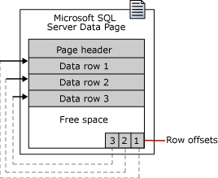
The Page
A page is a unit of allocation within the database.
Each 64KB page contains rows of data.

Slide 6
Page Splits
When a page becomes full, it splits.
This means more than just a new page being allocated—it also means that approximately half the data from the existing page is moved to the new page.

Slide 7
Rows
Pages consist of rows
A row can be up to 8KB
Limit of 8060 characters
Maximum of 1024 columns

Slide 8
Indexes
A database index is a data structure that is designed to improve the speed of operations in a table.
Indexes can be created using one or more columns, providing the basis for both rapid random lookups and efficient ordering of access to records.

Slide 9

Indexes
A table index is very similar to an index in a book
Using this analogy think of
  A database table → the book
  Rows of data → topics of interest within the book

Slide 10
How Can Data Be Found?
Following the book analogy:
  We could start at the beginning of the book and keep searching until we find the information we want
    Not efficient!
  Solution? We would use the book’s index to find where the information is located and then go after the information.
    Efficient

Slide 11

Database Efficiency
Like a book without an index, finding a specific row of data in an unindexed table will cause the entire table to be read (table scan) until the data is found.
The time to find a piece of data in a table without an index is proportional to the amount of data in the table.

Slide 12
Collation (Sorting)
In SQL Server, we have a number of different collation options available to us:
    Binary: Sorts by the numeric representation of the character (for example, in ASCII, a space is represented by the number 32, the letter “D” is 68, but the letter “d” is 100). Because everything is numeric, this is the fastest but it’s also not at all the way in which people think, and can also wreak havoc with comparisons in a WHERE clause.
    Dictionary order: Sorts things just as you would expect to see in a dictionary, in addition, it can set a number of different additional options to determine sensitivity to case, accent, and character set.

Slide 13
Collation – What is the significance?
Collation settings can be set at the database and at the column level
Affects the sort order of data
Affects the way data is stored in indexes
Default collation is case-insensitive, accent-insensitive
Once collation order has been set, it is difficult to change it

Slide 14
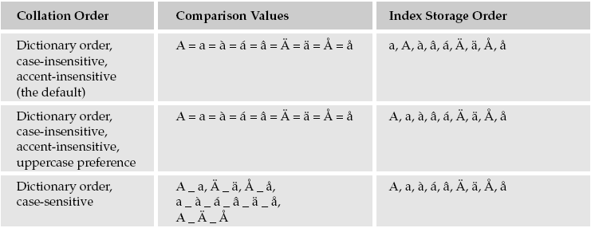

Sort Order

Slide 15
B-Trees
Data in SQL Server is stored in a B-Tree structure
A B-Tree (Balanced Tree) attempts to provide a consistent and relatively low-cost method of finding your way to a particular piece of information.
A B-Tree starts at the root node.
A node corresponds to a page in storage
This root node can, if there is a small amount of data, point directly to the actual location of the data.

Slide 16
B-Trees Continued
In most cases, there is too much data to reference from the root node, so the root node points at intermediate (non-leaf) nodes.
  Non-leaf nodes are nodes that are somewhere in between the root and the node that tells you where the data is physically stored
Non-leaf nodes point to other non-leaf nodes or to leaf nodes
  Leaf nodes contains a reference to the actual physical data

Slide 17
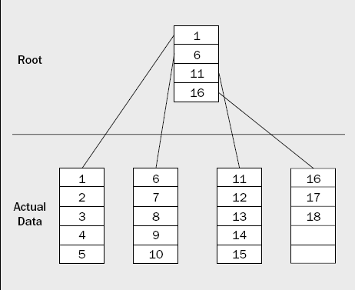
B-Tree Example
We start at the root and look through the records until we find the last page that starts with a value less than what we are looking for.
We then obtain a pointer to that node and look until we find the row we want.

Slide 18
Page Splits
When data is added to the tree, a node will eventually become full, and will need to split.
In SQL Server, a node equates to a page—this is called a page split.
When a page split occurs, data is automatically moved around to keep things balanced.

Slide 19
Page Splits
The first half of the data is left on the old page, and the rest of the data is added to a new page—thus you have about a 50-50 split, and your tree remains balanced.

Slide 20
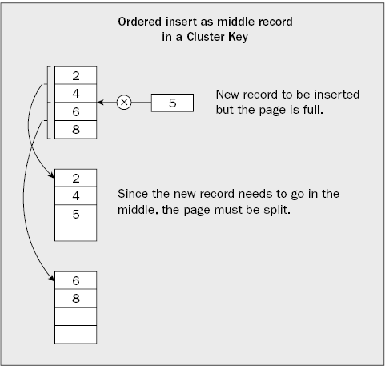
Page Splits

Slide 21
Page Splits cont.
Page splits adds a substantial amount of overhead at the time of the split.
Instead of inserting just one page, you are:
  Creating a new page
  Migrating rows from the existing page to the new page
  Adding your new row to one of the pages
  Adding another entry in the parent node

Slide 22
Page Splits cont.
The overhead doesn’t stop there as there is the possibility of a cascading action in the tree
  When you split, you need to create a new entry in the parent node which also has the potential to cause a split at that level, etc.
Page splits can have a very negative impact on system performance
We’ll talk about page-split prevention later in this chapter

Slide 23
Data Access
SQL Server retrieves the data you request in one of two ways
  Using a table scan
  Using an index

Slide 24
Table Scans
When a table scan is performed, SQL Server starts at the physical beginning of the table looking through every row in the table.
As it finds rows that match the criteria of your query, it includes them in the result set.
B-Trees: recall that this means it is searching the entire tree
Is often the most time-expensive method unless the table size is small
  In the case where the table size is small, table scans can actually be the most efficient

Slide 25
Indexes
Recall: Data is retrieved using a select statement
Table indexes optimize the way that data is retrieved on the given table and can speed the retrieval of data
A table can have more than one index
During the query optimization process, the optimizer takes a look at all the available indexes and chooses the best one based on your query (primarily what is in your WHERE clause & what you have joined tables on)
SELECT * FROM Persons
WHERE LastName = ‘Smith’

Slide 26
Indexes- How does it work?
Look up by Last Name. If an index on LastName exists, SQL Server will use it to find the data.
SELECT * FROM Persons
WHERE LastName = ‘Smith’

Slide 27
Indexes
Index types:
  Clustered indexes
  Non-clustered indexes—which comprise:
    Non-clustered indexes on a heap
    Non-clustered indexes on a clustered index
The way the physical data is stored varies between clustered and non-clustered indexes.
The way SQL Server traverses the B-Tree to get to the end data varies between all 3 types
The indexes are built over either a clustered table (if the table has a clustered index) or what is called a heap (what is used for a table without a clustered index)

Slide 28
Clustered Tables
A clustered table is any table that has a clustered index on it.
The data is physically stored in a designated order.
Individual rows are uniquely identified through the use of the cluster-key—the columns that define the clustered index.

Slide 29
Heaps
A heap is any table that does not have a clustered index on it.
In this case, a unique identifier, or row ID(RID) is created based on a combination of the extent, pages, and row offset (places from the top of the page) for that row.
A RID is only necessary if there is no cluster key available (no clustered index).

Slide 30
Clustered Indexes
Clustered index
  Is unique for any given table—you can only have one per table
  Exists as sorted row on disk
  Contains record in the leaf level of the B-tree
  Created for you by SQL Server when you create a primary key

Slide 31
Clustered Indexes cont.
In the case of a new record that needs to be inserted into the middle of the index structure, a normal page split occurs. The last half of the records from the old page are moved to the new page and the new record is inserted into the new or old page as appropriate.
In the case of a new record that is logically at the end of the index structure, a new page is created, but only the new record is added to the new page.

Slide 32
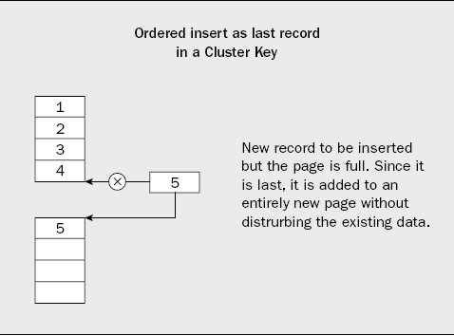
Clustered Indexes cont.

Slide 33
Non-Clustered Indexes on a Heap
There can be one or more Non-clustered indexes in a table.
Non-clustered index is the index in which logical order doesn’t match with physical order of stored data on disk.
Leaf level is not the data – it is the level at which you are able to obtain a pointer to the data
  Consider performance vs. the clustered index: if you are looking up records in a range, you may be reading all over the disk to find the data and may even return to the same page of data several times
  The pointer comes in the form of a RID which is made up of the extent, page and row offset for the particular row being accessed

Slide 34
Non-Clustered Indexes on a Clustered Table
Recall: A table can have more than one index
Recall: Any table with a clustered index has its rows stored in sorted order
With clustered indexes, when we got to the leaf level, we found the actual data. With non-clustered indexes on a heap, we didn’t find the actual data, but we did find any identifier that let us go right to the data (RID). With non-clustered indexes on a clustered table, we find the cluster-key at the leaf level. That is we find enough information to go and make use of the clustered index.

Slide 35

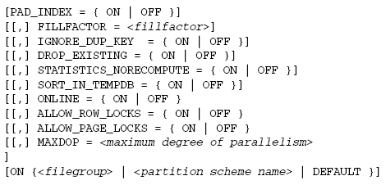
Creating Indexes
The CREATE INDEX creates an index on the specified table or view based on the stated columns.

Slide 36
Creating Indexes (cont’d)
Note that syntax looks familiar to other CREATE statements you have used
The next few slides will talk about the options unique to CREATE INDEX

Slide 37
Two Simple Index Examples
CREATE CLUSTERED INDEX Index_Name_Clstd ON Students(StudentID)
CREATE NONCLUSTERED INDEX Index_Name_NonClstd ON Students(LastName)

Slide 38
ASC/DESC
These two allow you to choose between an ascending and a descending sort order for your index.
Generally, you’ll want to keep the default of ASC.

Slide 39
ASC/DESC
An example of when you want to use the DESC -you need to mix ascending and descending order across multiple columns.
    SELECT * FROM Employees ORDER BY HireDate DESC, LastName ASC
    The index created to handle the query:
    CREATE NONCLUSTERED INDEX Index_HireDtDescLastNameAsc_NonClsd ON
    Employee(HireDate DESC, LastName)

Slide 40
INCLUDE
When you INCLUDE columns as opposed to placing them in the ON list, SQL Server only adds them at the leaf level of the index.
Because each row at the leaf level of an index corresponds to a data row, what you’re doing is including more of just the raw data in the leaf level of your index.

Slide 41
INCLUDE
Example query
Using INCLUDE will include the FirstName at the leaf node. B-tree is still sorted by LastName alone.
SELECT FirstName, LastName
FROM Students
WHERE LastName LIKE ‘Sm%’
CREATE NONCLUSTERED INDEX Index_Name_NonClstd ON Students(LastName) INCLUDE (FirstName)

Slide 42
Include cont.
Careful not to abuse this one! When you INCLUDE columns, you are enlarging the size of the leaf level of your index pages.
That means fewer rows will fit per page, and, therefore, more I/O may be required to see the same number of rows. The result may be that you effort to speed up one query may slow down others.

Slide 43
WITH
Tells SQL Server that you will indeed be supplying one or more of the options that follow.

Slide 44
PAD_INDEX
Determines just how full the non-leaf level pages of your index are going to be (as a percentage),when the index is first created.
You don’t state a percentage on PAD_INDEX because it will use whatever percentage is specified in the FILLFACTOR option that follows.
Setting PAD_INDEX = ON would be meaningless without a FILLFACTOR

Slide 45
FILLFACTOR
When SQL Server first creates an index on a table with data, the pages are, by default, filled as full as they can be, minus two records.
You can set the FILLFACTOR to be any value between 1 and 100. This number will be how full your pages are as a percentage, once index construction is completed.
Note that as your pages split, your data will still be distributed 50/50 between the two pages. You cannot control the fill percentage on an ongoing basis other than regularly rebuilding the indexes (something you should do as regular maintenance – see chapter 20 if interested)

Slide 46
IGNORE_DUP_KEY
The IGNORE_DUPLICATE_KEY option is relevant for indexes that have been created as UNIQUE
So what does UNIQUE do?
  The example below will not allow any rows inserted into the Students table with the same LastName value
CREATE UNIQUE NONCLUSTERED INDEX Index_Name_NonClstd ON Students(LastName)

Slide 47
IGNORE_DUP_KEY
IGNORE_DUP_KEY causes a UNIQUE constraint to have a slightly different action from that which it would otherwise have.
Normally, a unique constraint, does not allow any duplicates of any kind—if a transaction tried to create a duplicate based on a column that is defined as unique, then that transaction would be rolled back and rejected.

Slide 48
IGNORE_DUP_KEY cont.
With the IGNORE_DUP_KEY option, you will still receive an error message, but the error will only be of a warning level—the record is still not inserted.
A rollback isn’t issued for the transaction (the error is a warning error rather than a critical error) but the duplicate row will have been rejected.

Slide 49
IGNORE_DUP_KEY cont.
Why?
It’s a way of storing unique values, but not disturbing a transaction that tries to insert a duplicate.
For whatever process is inserting the would-be duplicate, it may not matter at all that it’s a duplicate row (no logical error from it).
Your process may have the attitude “Well, as long as I know there’s one row like that in there, I’m happy – I don’t care whether it’s the row I wanted to insert or not.”

Slide 50
IGNORE_DUP_KEY cont.
Default for IGNORE_DUP_KEY is OFF
Whether ON or OFF, using UNIQUE will cause a row with a duplicate LastName to not be inserted
When ON
  Generates a warning – will not roll back transaction
When OFF
  Generates an error – will roll back transaction
CREATE UNIQUE NONCLUSTERED INDEX Index_LastName_NonClstd ON Students(LastName)
WITH (IGNORE_DUP_KEY = ON)

Slide 51
DROP_EXISTING
If you specify the DROP_EXISTING option, any existing index with the name in question will be dropped prior to construction of the new index.
This is much more efficient than simply dropping and recreating an existing index when you use it with a clustered index.

Slide 52
DROP_EXISTING cont.
If you rebuild an exact match of the existing index, SQL Server knows that it need not touch the non-clustered indexes, while an explicit drop and create would involve rebuilding all of the non-clustered indexes twice in order to accommodate the different row locations.
If you change the structure of the index using DROP_EXISTING, the NCIs are rebuilt only once instead of twice.

Slide 53
SORT_IN_TEMPDB
When you create or rebuild an index, the B-Tree is constructed for that index
  This consumes resources
By setting the SORT_IN_TEMPDB option to ON you can direct the SQL Server Database Engine to use tempdb to store the intermediate sort results that are used to create/rebuild the index.
Note that by default intermediate results are stored in the given database you are using

Slide 54
SORT_IN_TEMPDB cont.
This option increases the amount of temporary disk space that is used to create an index, but could reduce the time required to create/rebuild an index when tempdb is on a set of disks different from that of the user database.
  When an index is built, the reads of the actual data can compete for I/O with the writes of the index build process. Therefore, by splitting them out, you can avoid I/O conflicts and potentially speed up the time to create/rebuild an index.
  There is no advantage to using this unless tempdb is on a separate physical drive.

Slide 55
ONLINE
ONLINE is OFF by default
ONLINE refers to the availability of the table while SQL Server is building an index for that table
Note that full index operations will grab the locks (eventually a table lock) it needs to have full and efficient access to a table. The side effect is that your users are temporarily blocked out.

Slide 56
ONLINE
With this ON, it forces the table to remain available for general access, and does not create any locks that block users from the index and/or table
  Keep in mind that there is a lot of additional overhead required in the index build for it to make sure that it doesn’t step on your users toes. This overhead could end up affecting your users in one way or another.
ONLINE index operations are supported only in the Enterprise Edition of SQL Server.

Slide 57
ALLOW ROW/PAGE LOCKS
The ALLOW settings here are setting directives regarding whether this index will allow page or row locks (placeholder to avoid conflicts in data integrity )or not.
Extreme performance tweak – this is an advanced topic and beyond the scope of this class.

Slide 58
MAXDOP
The degree of parallelism refers to how many processes are put to use for one database operation.
There is a system setting called the max degree of parallelism that allows you to set a limit on how many processors per operation.
The MAXDOP option in the index creation options allows you to set the degree of parallelism to be either higher or lower than the base system setting as you deem appropriate.

Slide 59
ON <Filegroup>
SQL Server gives you the option of storing your indexes separately from the data by using the ON option.
This means that:
  The space that is required for the indexes can be spread across other drives.
  The I/O for index operations does not burden the physical data retrieval.

Slide 60
XML Data
XML stands for Extensible Markup Language.
XML documents are designed to transport and store data.
Example XML data:
<?xml version="1.0" encoding="ISO-8859-1" ?>
- <note>
<to>Maria</to>
<from>John</from>
<heading>Movie</heading>
<body>Let’s go see a movie this weekend.</body>
</note>
Note the customized tags for individual information fields (to, from, heading, body)
SQL Server can store XML data in a data type called XML

Slide 61
Creating XML Indexes
Unlike the relational data that we’ve been looking at thus far, XML tends to be very unstructured data. It utilizes tags to identify data, and can be associated with what’s called a schema to provide type and validation information to that XML-based data.
The unstructured nature of XML requires the notion of “navigating” or “path” information to find a data “node” in an XML document.

Slide 62
The Primary XML Index
The first index you create on an XML index must be declared as a “primary” index.
When you create a primary index, SQL Server creates a new clustered index that combines the clustered index of the base table together with data from whatever XML node you specify.
CREATE PRIMARY XML INDEX INDEX_NOTES_XML
ON Notes (NotesText)

Slide 63
Secondary XML Indexes
Secondary XML indexes point at primary XML indexes.
Once you create a primary XML index, you can create up to 248 more XML indexes on that XML column.
Syntax:
  CREATE XML INDEX index_name
  ON table_name (xml_column_name)
  [USING XML INDEX xml_index_name
  [FOR {VALUE|PATH|PROPERTY}]
CREATE XML INDEX INDEXPATH_NOTES_XML ON Notes (NotesText) USING XML INDEX INDEX_NOTES_XML
FOR PATH

Slide 64
Implied Indexes Created with Constraints
Some indexes are created automatically when you add a constraint. These are called implied indexes.
Implied indexes are created when one of two constraints is added to a table:
  A PRIMARY KEY
  A UNIQUE constraint (aka, an alternate key)

Slide 65
Deciding What Indexes to Use
Choosing what indexes to include and what not to include on a table can be a tough process

Slide 66
Selectivity
Indexes, particularly non-clustered indexes, are primarily beneficial in situations where there is a reasonably high level of selectivity within the index.
Selectivity is the percentage of values in the column that are unique.
Example of a high level of selectivity: SSN
Example of a low level of selectivity: Gender

Slide 67
Selectivity
The higher the percentage of unique values within a column, the higher the selectivity is said to be, and the greater the benefit of indexing.
Example of a bad column to index in a Person table: Gender. There will be overhead incurred by adding the index that will not be offset by the benefit of the index.
If one lookup in your non-clustered index is going to generate multiple additional lookups in a clustered index, then you are probably better off with a table scan.

Slide 68
Selectivity (cont’d)
Non-clustered Index:
  Recall that the lookup in a non-clustered index over a clustered index is really only the beginning. You will still need to make another loop through the clustered index in order to find the real data.
  If one lookup in your non-clustered index is going to generate multiple additional lookups in a clustered index, then you are probably better off with a table scan.
Clustered Index:
  Clustered indexes are less affected by selectivity because, once you are at the start of your range of data – unique or not- you’re there. There are no additional index pages to read.

Slide 69
Indexes and Foreign Keys
Regardless of selectivity, it is usually beneficial to add an index on a foreign key. Recall that a foreign key is used to join two tables.
Indexes can be instrumental in join performance.

Slide 70

Dropping Indexes
If you’re constantly re-analyzing the situation and adding indexes, don’t forget to drop indexes, too.

Slide 71
Choosing Indexes
Choosing what indexes to include and what not to include can be a tough process and you have to make some decisions about what type you want them to be.

Slide 72
Choosing Which Indexes To Create
Look at how your tables are being used in queries when deciding which indexes to create
  Look at the JOIN, ORDER BY, or WHERE clauses of queries on your table. This is how data will be “looked up” by SQL Server and is therefore what you want to optimize.
  Each index should be targeted for a specific lookup (i.e. you don’t create just one index with all columns to be used for all queries)
Be conservative – indexes do create overhead so don’t create indexes on everything

Slide 73
Choosing an Order for the Columns in Your Index
Consider that it is the optimizer that ‘decides’ whether a particular index is used or not
Consider also that an index can contain multiple columns
An index is only considered for use by the optimizer if the first column listed in the index is used in the query – therefore the order of the columns specified in your query matter
The index will totally be ignored if the first column of the index isn’t mentioned in the JOIN, ORDER BY, or WHERE clauses of the query.

Slide 74
Guidelines to Remember
Clustered indexes are usually faster than non-clustered indexes
Only place non-clustered indexes on columns where you are going to get a high level of selectivity (>=95%)
All Data Manipulation Language (DML: INSERT, DELETE, UPDATE, SELECT) statements can benefit from indexes, but inserts, deletes and updates are also slowed by indexes because the indexes have to be maintained
Indexes take up space

Slide 75
Guidelines to Remember
Indexes are only used if the first column in the index is relevant to your query
Indexes can hurt as much as they help
Indexes can provide a performance boost to XML data, but there is overhead involved
If multiple columns are in an index, pay attention to the order of the columns
Only add columns to your index if they will be used to find, sort, or join the data (i.e. don’t just index all columns)

Slide 76
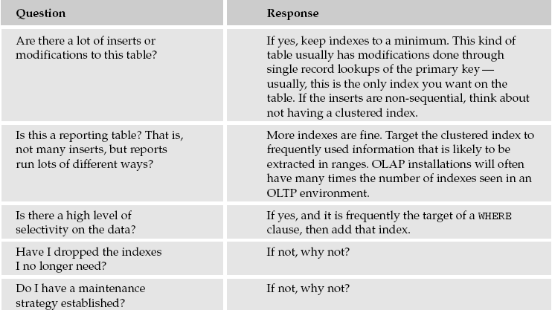

Slide 77
Maintaining Your Indexes
There are two issues to be dealt with in terms of maintaining indexes
  Page splits
  Fragmentation

Slide 78
Fragmentation
Fragmentation of your data occurs over time because your database grows, pages split and eventually data is deleted
You may have the situation where many of your data pages are only holding a small fraction of the amount of data they could hold
Additionally, records could be spread out all over the place and cause additional overhead in data retrieval

Slide 79
Maintenance Solution
The database administrator typically sets up a job that rebuilds indexes periodically (example weekly)
To rebuild indexes you can either drop them and create them again or use the ALTER INDEX command with the REBUILD option.

